Slide 1

Prudential Insurance Risk Prediction
– Vivek Gulavani

Slide 2

Problem Statement
Insurance Approval is Complex Process
It involves collection of extensive personal and medical information
Analyzing the information and assigning a Risk is a manual process
Manual Process causes delay in Insurance approval
Automation of Risk Predication is required to Improve Business Efficacy

Slide 3
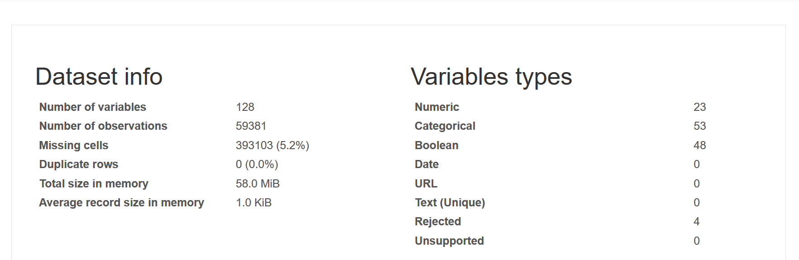
Dataset Overview

Slide 4
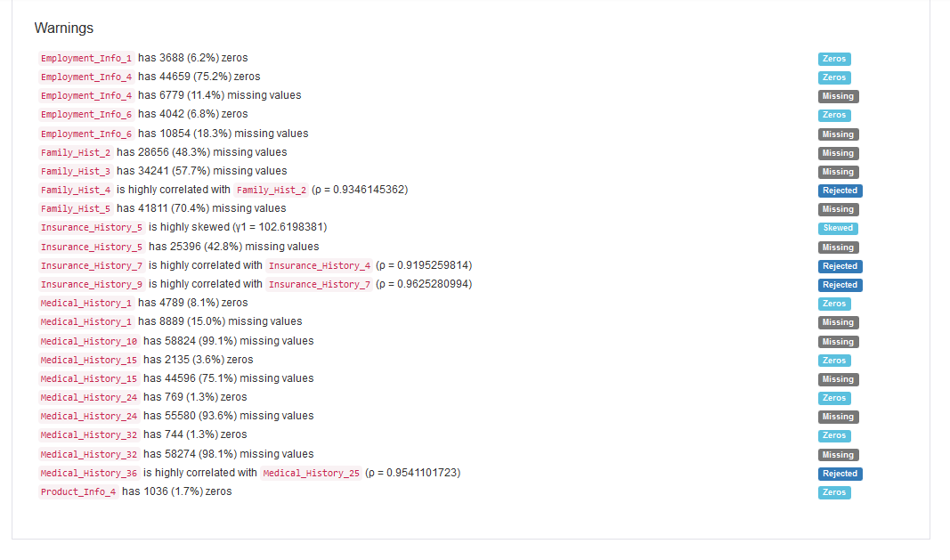

Slide 5
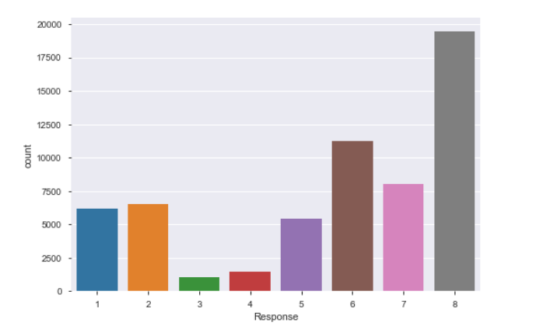
Type of ML Problem - Multilevel Classification OR Regression
127 Features
Target
Response
Unbalanced Distribution

Slide 6
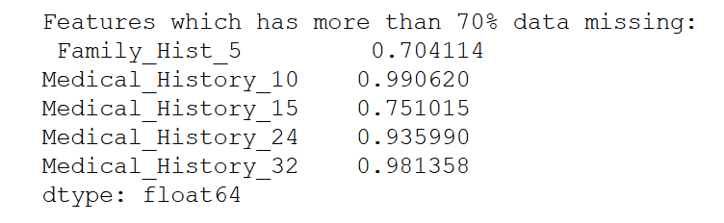
Data Transformation
Dropped features with > 70% missing data
Label Encoding of Product_Info_2
Transform Categorical Column
Impute Missing Values with Mean
Imputation of Missing Values
Drop Features with high Multi-collinearity

Slide 7
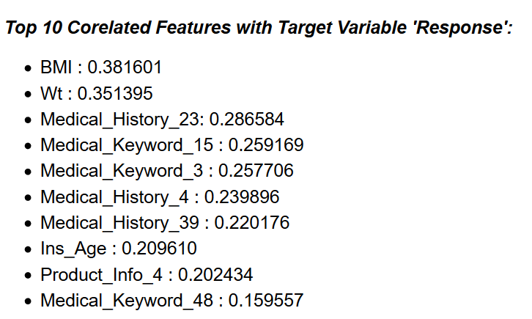
Correlation With Target Variable

Slide 8
ML Algorithms Used
Classification
Regression
Decision Tree
Random Forest
Linear Regression
Decision Tree Regressor
Random Forest Regressor
GridSeachCV
RandomizedSearchCV
GridSeachCV
RandomizedSearchCV

Slide 9
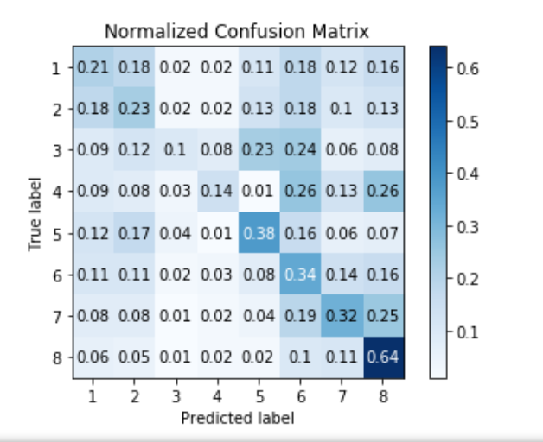
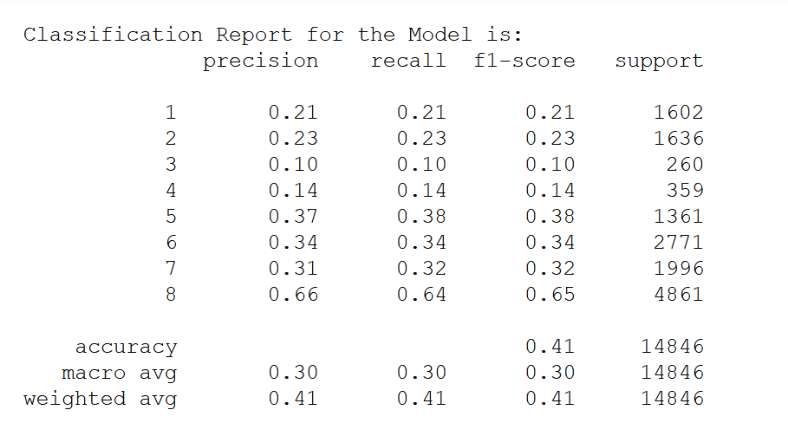
Decision Tree Classifier
Train – Test Split: 75:25
Accuracy

Slide 10
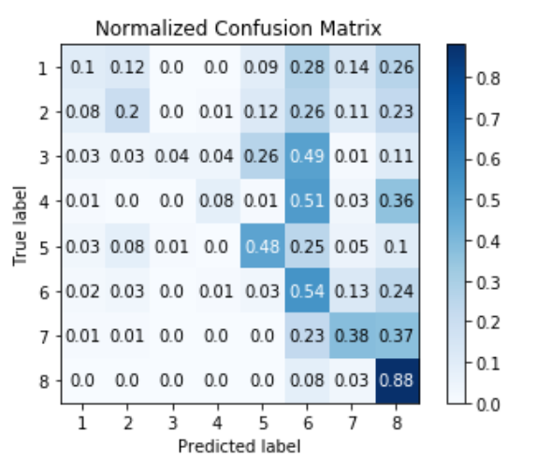
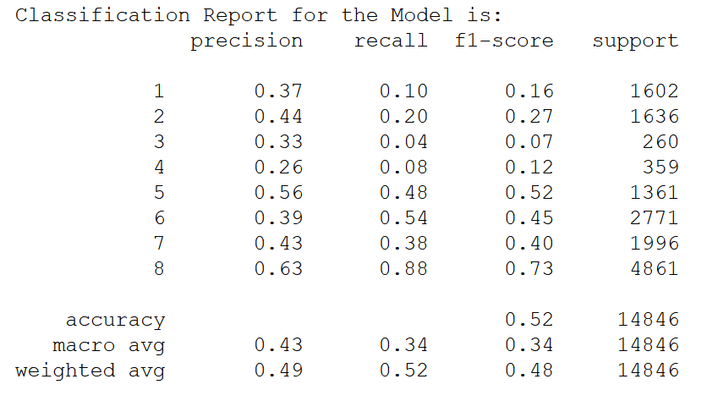
Decision Tree Classifier – GridSearchCV
Train – Test Split: 75:25
Accuracy

Slide 11
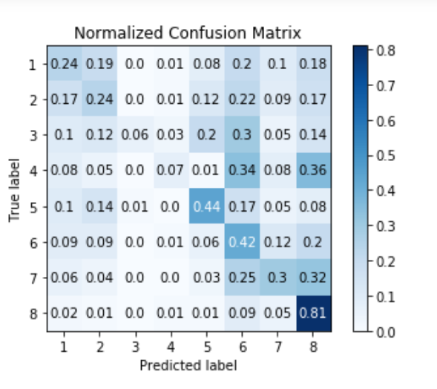
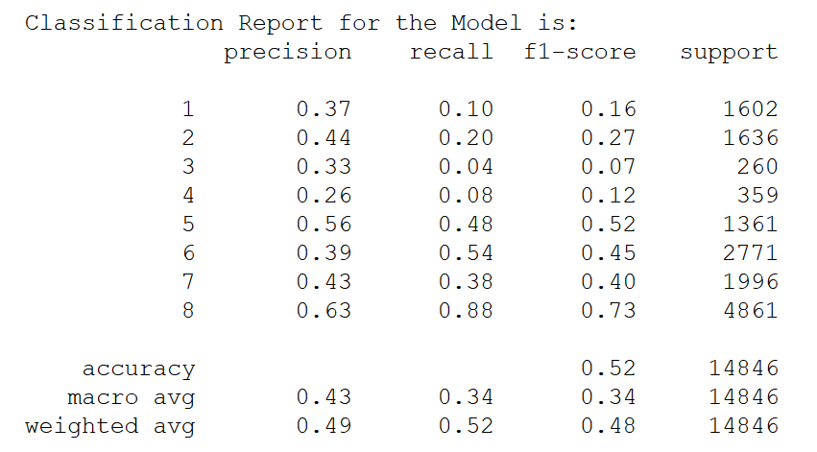
Random Forest Classifier
Train – Test Split: 75:25
Accuracy

Slide 12
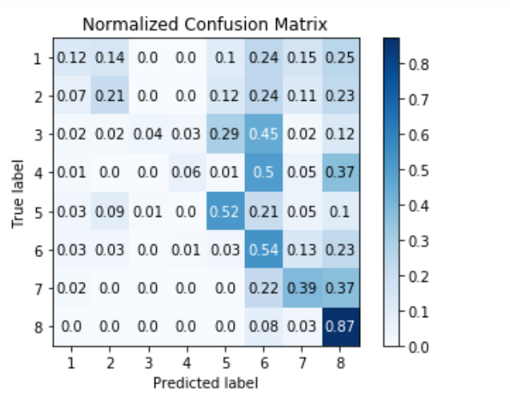
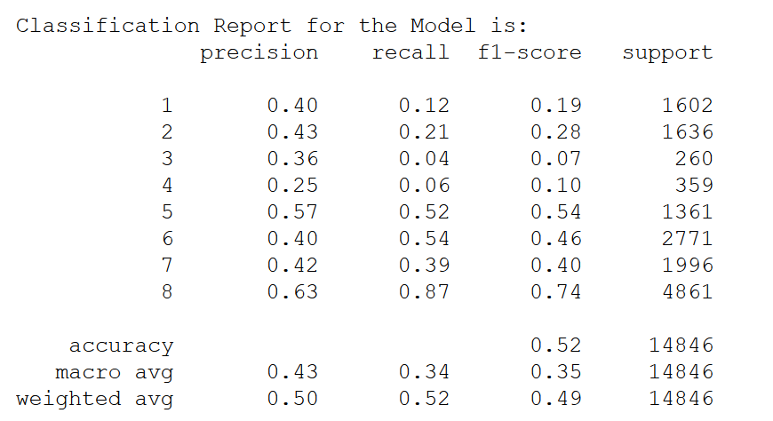
Random Forest Classifier – RandomizedSearchCV
Train – Test Split: 75:25
Accuracy

Slide 13
Linear Regression
Train – Test Split: 60:40
Without Grid Search
MAE for test set is 1.56
MSE for test set is 4.00
RMSE for test set is 2.00
R**2 for test set is 0.34
Adjusted R**2 for test set is 0.34
Best Params
copy_X = ‘True’
fit_intercept = ‘True’
normalize = ‘True’
With Grid Search
MAE for test set is 1.75
MSE for test set is 4.71
RMSE for test set is 2.17
R**2 for test set is 0.23
Adjusted R**2 for test set is 0.22

Slide 14
Decision Tree & Random Forest Regressor
Train – Test Split: 60:40
Decision Tree Regressor
MAE for test set is 1.76
MSE for test set is 7.44
RMSE for test set is 2.72
R**2 for test set is -0.22
Adjusted R**2 for test set is -0.23
Random Forest Regressor
MAE for test set is 1.53
MSE for test set is 4.18
RMSE for test set is 2.04
R**2 for test set is 0.31
Adjusted R**2 for test set is 0.31

Slide 15
Random Forest Regressor - RandomizedSearchCV
Train – Test Split: 60:40
Best Params
{'n_estimators': 20,
'min_samples_split': 9,
'min_samples_leaf': 3,
'max_features': 'sqrt',
'max_depth': 30,
'criterion': 'mse',
'bootstrap': False}
’
Random Forest Regressor
MAE for test set is 1.52
MSE for test set is 3.82
RMSE for test set is 1.95
R**2 for test set is 0.37
Adjusted R**2 for test set is 0.37

Slide 16
Dimensionality Reduction
Methods Used
PCA
Negative Impact on Model Accuracy
RFE

Slide 17
Model Comparison - Classification
Selected Classification Model
RF With RandomizedSearchCV
Highest Accuracy – RF with RandomizedSearchCV – 0.524
Highest Precision – RF with RandomizedSearchCV – 0.5
Observations
Accuracy of prediction is lower.
Data is unbalanced so recall for Response value ‘8’ is highest and very low for ‘3’ and ‘4’
Tried Using SMOTE to balance the data however accuracy reduced with increase in recall for ‘3’ and ‘4’
Tried Using PCA and RFE for dimensionality reduction however it further reduced the accuracy

Slide 18
Model Comparison Regression
Selected Regression Model
Random Forest Regressor
Random Forest with Hyper Parameter Tuning Provides Best Results
Observations
Random Forest Regressor with Hyper parameter Tuning gives best results
All models accuracy reduces with PCA
No Major improvement observed over Linear Regression
Best results obtained with 60-40 Train Test Split

Slide 19
Conclusion
Regression Models perform faster that Classification
MAE for Random Forest Regressor is 1.52
This means the risk prediction will be within difference of 2 with actual risk value in case of regression.
In classification we can’t see how much difference would be in Risk Value and accuracy is lower
Selected Model for Prediction
‘Random Forest Regressor’ with Hyper Parameter Tuning

